Slide 1
Creativity Education in the World
Kenichi YUMINO, Ph.D
Shizuoka University, Japan

Slide 2
What is Creativity Education?
Learning and Creation⇒Japanese like learning, not creation.
Confucianism: Learn from authorities(Teacher, Famous books) is good.
Learn Basics and foster creativity ⇒ important
There are a lot of ways to foster creativity
Improve(curriculum, teaching method), raise (motivation, curiosity, braveness), etc.
Education that weigh on not only products but also learning processes
Education that weigh on values that characterized ideas, actions and expressions of the person

Slide 3
Why Creativity Education is so important now days?
Maintain a limited earth environment.
Blue diode(Dr. Nakamura invented) , a fuel battery car, etc.
For the succession of an unique culture of each country.
Fostering abilities that lead Knowledge-Creation Society.
Appearance of life-span learning society.
Make a meaningful life.
A few Japan’s elementary and high schools introduced Creativity Education. But at the under- & graduate schools, several schools introduced it(mainly engineering and business areas, not an education area.

Slide 4
Creativity Education in England
From 2000：QCA-Project began
More than １０００ primary and secondary schools introduced
In a subject or cross-curriculum
What is creativity?
/Imagination/Imagination with purposes/Originality of the products/Have the products value in the light of aims?
Example
・Victoria Primary(Leeds)
・Teachers’ Kit (100 pages manual: QCA made)

Slide 5
Creativity: Find it, Promote it http://www.ncaction.org.uk/creativity/index.htm
What is creativity?
Why is creativity so important?
How can you spot creativity?
How can teachers promote creativity?
How can heads and managers promote creativity?
Creativity in action examples
Organization and resources
About QCA’s creativity project

Slide 6
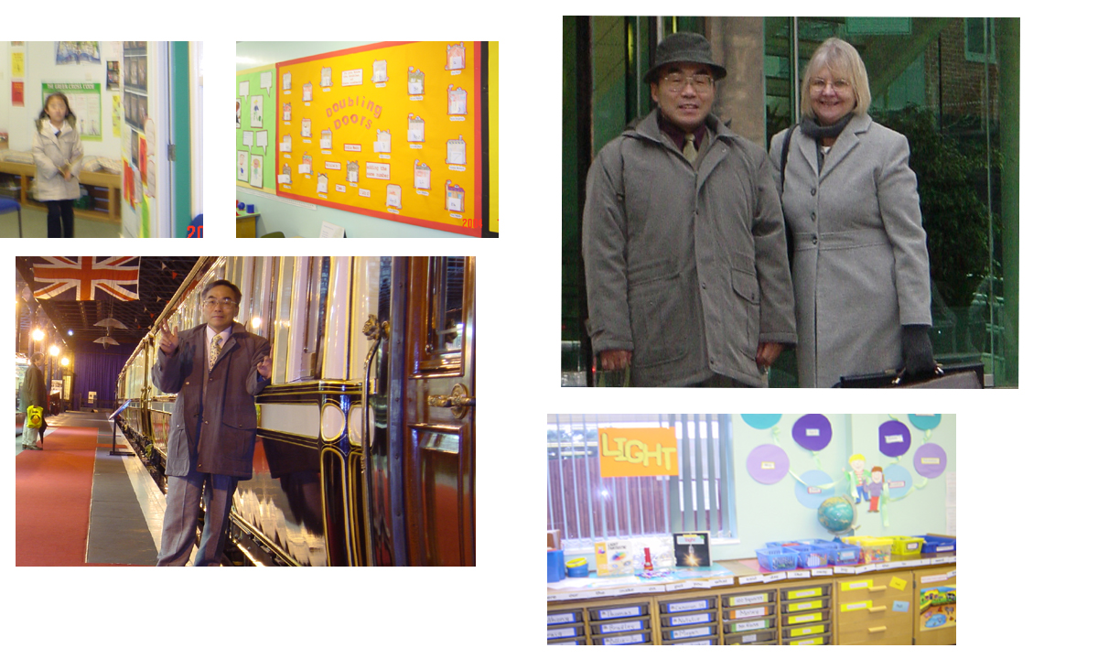
写真

Slide 7
Creativity Education in USA & Canada
Colleges & Graduate Courses
USA: ・Harvard ・NY State-U Buffalo ・Georgia ・Iowa
・UC Santa Barbara
Canada: ・UBC ・Univ. of Alberta ・Univ. of Calgary
Elementary & High-School
Thousands of schools and classes
Gifted & Talented Education
・About 10% of Students take( differ from state to state)
・Training : Workshop of CPSI

Slide 8
Harvard Critical/Creative Thinking Course(MA)
The CCT Program provides students with an understanding of the processes of critical thinking and creativity.
CCT courses and workshops have covered psychological studies of the scope, limits, and techniques of critical and creative thought, information processing, and conceptual learning in children and young adults
; philosophical studies of techniques in reasoning, argument, logical thinking, valuing, and judging; and work with cognitive structures and metacognitive techniques for stimulating creativity and critical thought. At the same time, social justice concerns motivate the work of many CCT students and faculty.
Philosophical studies of techniques in reasoning, argument, logical thinking, valuing, and judging; and work with cognitive structures and metacognitive techniques for stimulating creativity and critical thought. At the same time, social justice concerns motivate the work of many CCT students and faculty.

Slide 9
NY State Buffalo-Creative Studies Course（MA）
More than 100 Students learn 4-P(Muneyoshi, 2005).
1)Person: Fostering creative personality.
2)Process: Creative problem solving.
3)Product: What is creative products.
4)Press: To study the environments that develop creativity.
It is so important that how much members concern about the activities of the team.
Here, the lectures, practices, workshops that develop creativity are teaching.
10 subjects that are opened: Creative problem solving, etc.

Slide 10
Entrepreneurship- & Creativity Education in Finland
Entrepreneurship Edu. Kinder to College.
Intra Entre. Vs Extra Entre（）.
Extra Entre.: All things that need to initiate real business.
Intra Entre.: Following abilities can be taught in school.
Diligence, Initiative, Willingness to be of service.
Social Skills, Flexibility, Self-confidence,
Desire to improve oneself, Creativeness, Boldness
Ability to make choices

Slide 11
Entrepreneurship Edu（Example）
Traditional foods, European dressing, European manner/ greeting, Business customs/ negotiation, Cost rating, Economics, Business letter, CM sentences, Sales speech, Budget, Bank systems, Advertising, Insurance, etc. Display, Design, Aesthetic aspects of the goods, Traditional hands crafts, etc.

Slide 12
Creativity Education in China
China Creativity Studies Institute（Mem:, 10,000, 1994 ）
More than 200 experimental sites( primary, secondary, college)
More than 100 colleges made “creativity course”
Fostering Creativity -> National basic policies:
1)Creativity cultivating system that is peculiar to China.
2)Establish curriculums for developing creativity.
3) Increase subjects for fostering creativity in engineering & managing fields.
Characteristics of Creativity Edu. in China
Single subject to all subjects.
Individual teacher to all of the teachers in the school.
Move “a stage of trial & errors” to “a stage of the theory lead”.
Move a stage of success in small areas to a stage of getting harvests in broader areas.

Slide 13
Creativity Education in China（2）
Shanghai Bunkou High School（Example）
1. Creativity Education was built into the School System
（１）Philosophy of innovative spirit & personality was made.
（２）Science & Technology Center was built.
（３）Creativity Education was introduced into each subject.
（４）School Company was made.
This school has circles of “Invention”, “Information, Science & Technology”, and “Biotechnology”.
（５）Evaluation System for Creativity Education exists.
（６）The school has a network to the professional experts & organization.
2. Creativity Education developed many aspects of the students’ ability.
3. Creativity Education raised practical abilities of the students.

Slide 14
Creativity Education in Taiwan
Taiwan interested in Creativity since1960s.
1975←Elementary School: Goal→Creativity
1988→Creative Thinking Center : Taipei City Teachers College.
1999→Cre. Edu. Included in the Law of Education.
2000→Teachers Training for Cre. Edu.
2002→Made “Mailing List “ for Elementary & High School Teachers.
Organization
Taipei City Teachers College.
Taipei Teachers College.
College of Politics.
Taito University
Many Ele. & High Schools.
Creativity Fostering Center→２０ Colleges.

Slide 15
Creativity Education(Example)
Rika Ele. School.
Fostering Creativity:
Pottery, Traditional musical. Nature exploring, Art & Musical Festival,Play flute.
Taito Shisei High School.
Goals:
Move actively, Creation & Innovation, Growth.
Students are grouped into Arts, Physical Edu., Music, and Math & Science.
They are took Creativity Edu. And got a lot of awards.

Slide 16
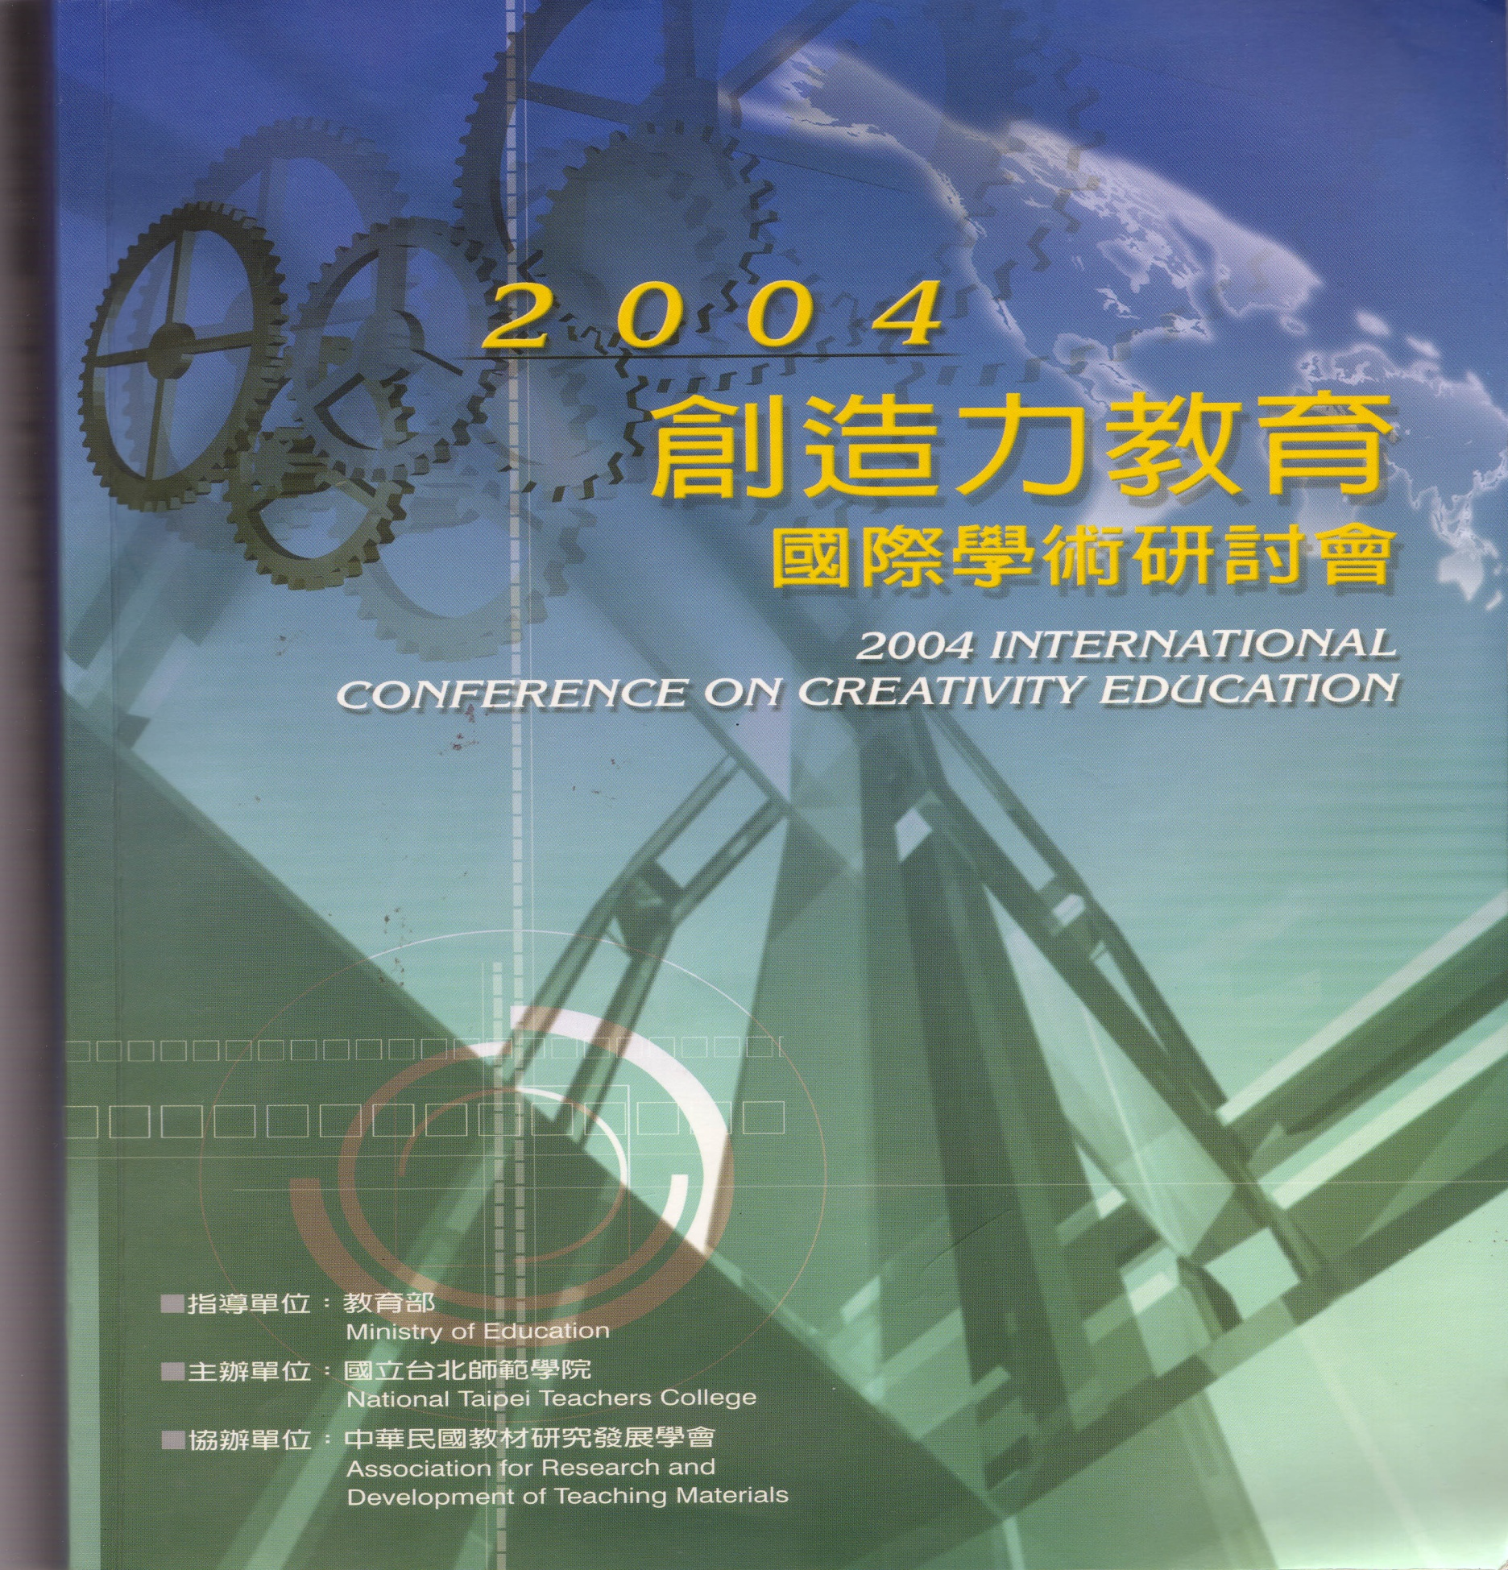
2004 Creativity Conference

Slide 17
Creativity Education in Japan
Comparing total hours of Math+Science（9th grade）in a year.
Japan 154 UK 228 German 226 France 259
USA 295 Austria 390
Creativity Education in Japan(1965-70s)
A lot of schools introduced CreEdu. Books: 57
Now very few: Full: Fukushima Univ. attached High-School.
Partly: many schools want to develop creativity in “ Integrated Study” that begins at 3rd and ends 12th grade.
Through Robot Contest, many Colleges, technical high schools , higher technical high schools are fostering creativity.
Creativity research program: several universities including “Shizuoka Univ.”.

Slide 18
Lessons aim at Creativity (YUMINO Advice:Fukushima Univ. Attached High-School）
Japanese Language
Make images from a picture.
Social Studies
What attract people to the Station Area?
Math
Divide equally two an nonsymmetrical figure.
Science
Imagine the shapes of volcano and ascertain the shapes using by raw cream.
Arts
Create 3-dimensional art that fit to background landscape.
Physical Education
Make an exercise that develop full-body endurance.
Engineering
Make a calendar using by suitable softwares.
Homemaking
Make a 3-dimensional dress using 2-dimensional forms.

Slide 19
福島

Slide 20
"Period of Integrated Study“ 110 hours/ year
Interdisciplinary and comprehensive courses such as international understanding/ foreign language conversation, information education, environmental education and welfare education .
It aims at helping a child develop capability and ability to discover and to properly solve problems by oneself.
It emphasizes to employ the hands-on learning and the problem-solving approaches as in experiential activities in nature and social activities like volunteer activities, experimentation/ observation, inquiring, creative activities and other productive activities.

Slide 21
Themes of Integrated Study (6th graders:examples)
Soccer: improvement of kicks & physical strength.
How to make good teeth?
How wind available in the human life?
Make a wonderful musical.
Mystery of human body and various responses.
Flying mechanisms of the plane.
How a hearing dog available for him/her?
About a dream/ sleep.
How to make a good design car?
The reasons why dinosaurs extinguished.
Medicine and disease.
Ballet and music.
How was humankind born?

Slide 22
Fostering Creativity The Practices of Student Teachers that Facilitate Pupils' Understanding of Flying Mechanism Deeply and Broadly( Ken YUMINO)

Slide 23
Fostering Creativity [Understand deeply]
(a) Why does a "lift" occur at the wing which is flying in a level flight?
(b) Can an airplane keep flying in reversed state?
(c) What role does the aileron (extra wing) which comes out at landing situation?
(d) Is the theory that the whirl flow on the surface of wings generates the lift right?
(e) Can the Theorem of Berunui explain all of a lift that generated in flying?
(f) Is a principle of an airplane flies the same as a principle of a kite flies?
(g) Why can a paper airplane fly, although wings are even?
(h) How a helicopter and an insect fly?

Slide 24
Fostering Creativity [Understand broadly]
(a) How had an airplane progressed?
(b) How the development of airplane affected on our life?
(c) When an airfield is made in some city, how does the industry, the education, and culture grow?
(d) In order to fly safely, how is the airline company endeavoring?
(e) How are the airplanes loading on weight on the environments?

Slide 25
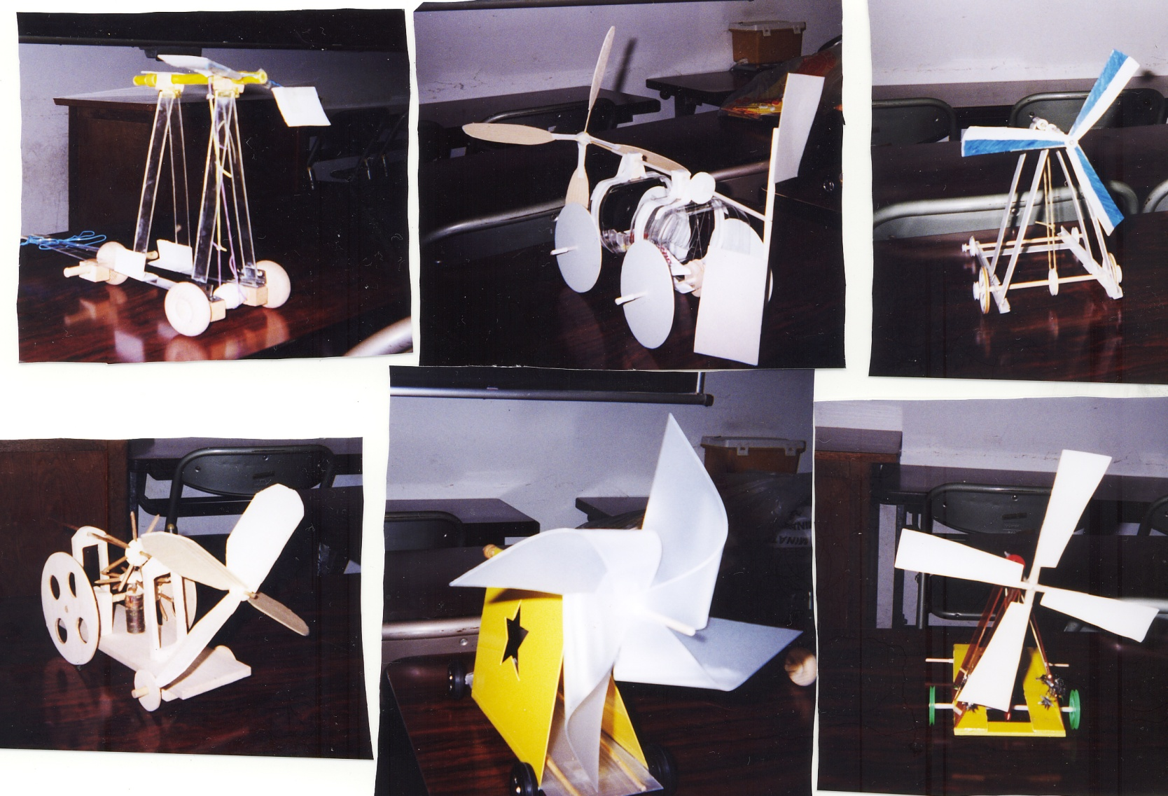
Fostering Higher Teaching Skills through Making a Wind-Car

Slide 26
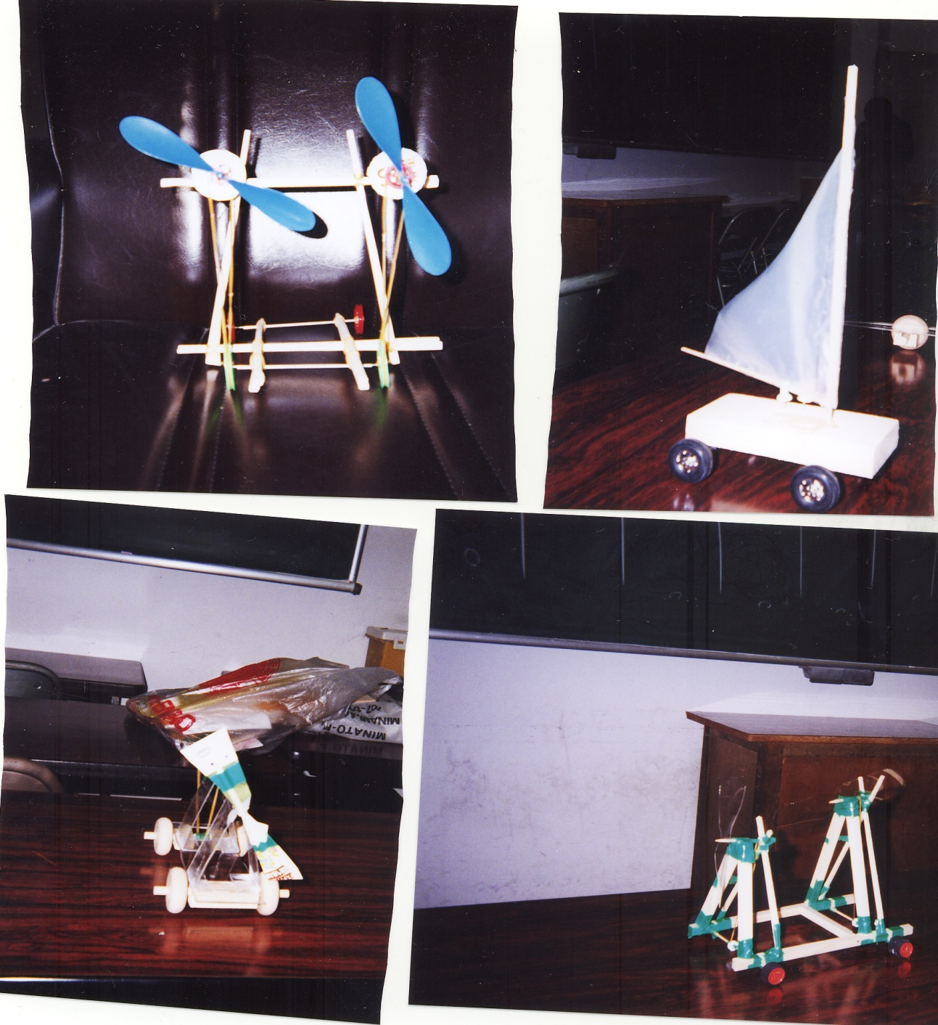
Fostering Higher Teaching Skills through Making a Wind-Car（２）

Slide 27
Information
YUMINO: Fostering Creativity in “ Integrated Study”
Creativity Education in the World.
Including USA, Canada, England, Finland German, China, Taiwan, Japan
Japan Creativity Society http://wwwsoc.nii.ac.jp/jcs2/index.html
YUMINO’s HP
http://sparc07.ed.shizuoka.ac.jp
Mail
yumino@sparc07.ed.shizuoka.ac.jp

